Slide 1
William Shakespeare

Slide 2
“Who is this dude?” “Is Shakespeare a play?”
Famous poet and playwright
People often label him as the best writer in the English language
Wrote over 35 plays and 154 Sonnets
Does Romeo and Juliet ring a bell? How about Gnomeo and Juliet?

Slide 3
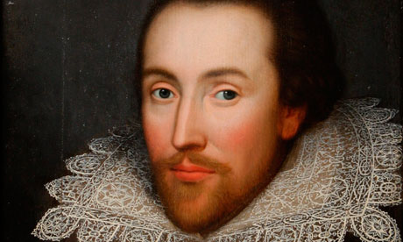
“Is he still alive?”
Shakespeare lived to 52. It is known that he was born in sometime in 1564 ( the specific date is uncertain) and that he died on 23rd April 1616

Slide 4
http://www.online-literature.com/periods/timeline.php

Slide 5
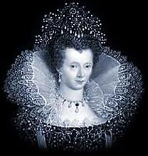
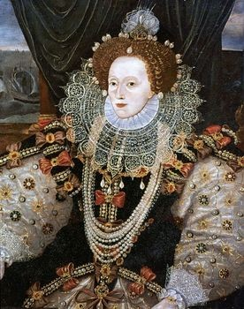
The Elizabethan Period
Associated with the reign of Queen Elizabeth from 1558-1603
Height of the English Renaissance (rebirth) where art, music, poetry, and literature flourished
Elizabeth managed the conflicts between Catholics and Protestants well

Slide 6
Interesting Facts
Shakespeare did not go to college
Despite his fame, we know very little about his life. Some critics actually argue that Shakespeare did not write his plays himself
His family was illiterate
Acted minor roles in his plays
Women’s role in his plays were often played by men because it was unacceptable for women to act

Slide 7
“Why do we have to learn about him?”
His stories transcend his time period and are still relatable and enjoyed by modern audiences.

Slide 8
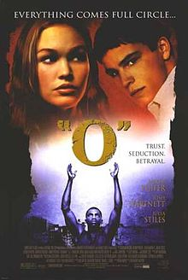
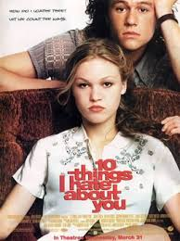
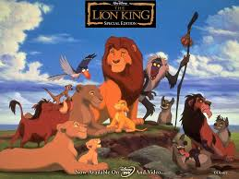
Oh, you don’t believe me?

