Slide 1
WORDS ARE POWERFUL

Slide 2
WORDS ARE POWERFUL
http://www.youtube.com/watch?v=Hzgzim5m7oU

Slide 3
LITERAL & FIGURATIVE MEANING
LITERAL
FIGURATIVE
When words mean exactly what they say in their most basic sense
When words create an image or suggest an idea through the use of metaphors, similes, etc.

Slide 4
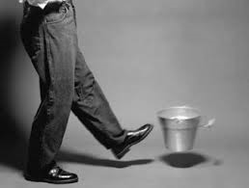
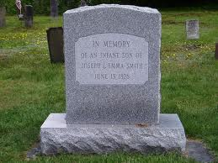
He kicked the bucket.
The man kicked the bucket with his foot.
The man passed away.

Slide 5
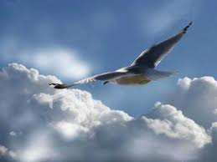
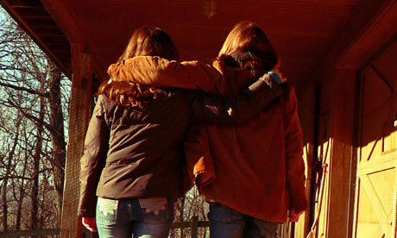
You are the wind beneath my wings.
You are the actual wind that flows underneath my wings.
You are a supportive and helpful person who keeps me going.

Slide 6
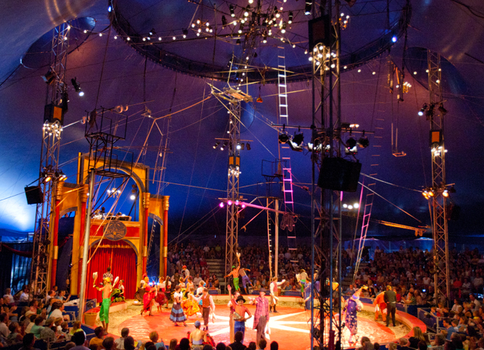
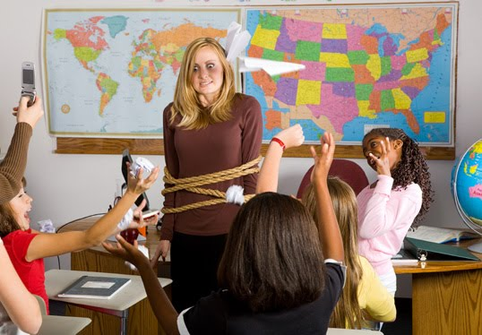
This class is like a three-ring circus.
There are clowns, acrobats, animal trainers, and performers in this class.
The students are acting wild and crazy.

Slide 7
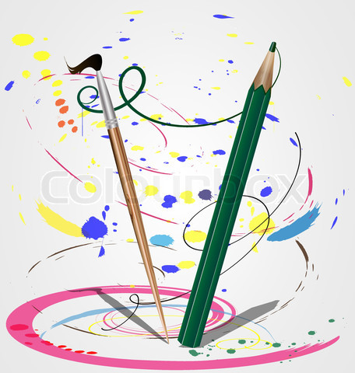
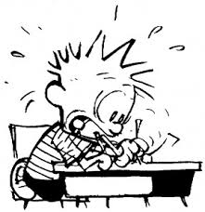
The pencil danced across his page.
Wow! Look at that pencil dancing! I didn’t know it could dance!
The student only had five minutes to finish the test so his pencil was moving quickly on the page.

Slide 8
DENOTATION & CONNONATION
DENOTATION
CONNOTATION
The literal, direct, or realistic meaning of a word that is often found in the dictionary.
***To help you remember this, the "d" in denotation equals dictionary***
When words create an image or suggest an idea

Slide 9
SCRAWNY
DENOTATION
CONNOTATION
excessively thin
wimpy, unathletic

Slide 10
Cheap
DENOTATION
CONNOTATION
costing very little; relatively low in price; inexpensive
poor quality

Slide 11
WHICH WORD SOUNDS MORE POSITIVE?

Slide 12
Our trip to the amusement park was _____.
a) fine
b) wonderful

Slide 13
We saw _____ animals in the animal house.
a) fascinating
b) weird

Slide 14
Some of the monkeys made _____ faces.
a) hilarious
b) amusing

Slide 15
Everyone had a _____ on his or her face on the way home.
a) smile
b) smirk

Slide 16
We bought _____ souvenirs at the amusement park.
a) cheap
b) inexpensive

Slide 17
WHICH WORD SOUNDS MORE NEGATIVE?

Slide 18
I ate a ________ sandwich.
a) soggy
b) moist

Slide 19
Mike _____ us to go to the funny house.
a) nagged
b) reminded

Slide 20
I didn't like the _____ on the jester's face.
a) smirk
b) grin

Slide 21
It made me feel _____.
a) uneasy
b) frightened

Slide 22
WHAT IS THE BEST ANSWER?

Slide 23
Which is worth more?
a) something old
b) something antique

Slide 24
Which is better?
a) to be skinny
b) to be slender

Slide 25
Which would you rather be called?
a) thrifty
b) cheap

Slide 26
Which is more serious?
a) problem
b) disaster

Slide 27
Which is more polite?
a) sip a drink
b) gulp it

